Slide 1

UNIVERSITY INSTITUTE OF ENGINEERING
COMPUTER SCIENCE ENGINEERING
Bachelor of Engineering (Computer Science & Engineering)
Subject Name: Block chain Technology
Subject Code: 20_CST-412
Introduction to popular block chain Plat forms
Mapped with CO2
Prepared By:
Er. Ankita Sharma
DISCOVER . LEARN . EMPOWER

Slide 2
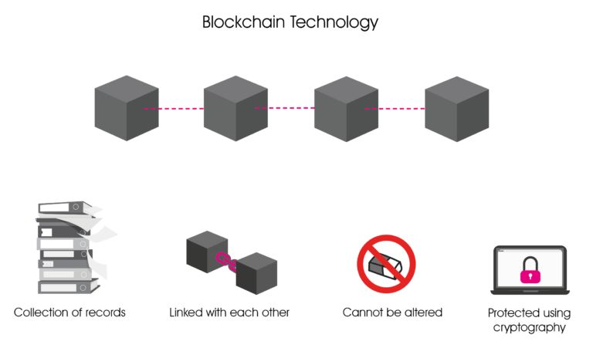
Definition
Introduction to popular block chain platforms
Block chain platform technology is a decentralized solution to tracking, documenting, and facilitating transactions. These tools create a public ledger relying on globally distributed historical transactions to prevent tampering and fraud. Each interaction is documented in a database that relies on each previous, time-stamped transaction to verify and execute an exchange.
Credit: www.ikigailaw.com

Slide 3
There are several blockchain platforms available that provide the infrastructure and tools to develop and deploy blockchain applications. Here are some of the prominent blockchain platforms:
Ethereum: Ethereum is a decentralized, open-source blockchain platform that supports smart contracts. It has its own cryptocurrency called Ether (ETH) and is widely used for developing decentralized applications (DApps), token creation, and executing complex smart contracts. Ethereum introduced the concept of programmable blockchain, enabling developers to build a wide range of decentralized applications.
Bitcoin: Bitcoin is the first and most well-known blockchain platform. It primarily serves as a peer-to-peer digital currency system, allowing for secure and transparent transactions. Bitcoin's blockchain is focused on maintaining a decentralized digital currency network, and its scripting language provides limited functionality compared to platforms like Ethereum.

Slide 4
Binance Smart Chain (BSC): Binance Smart Chain is a blockchain platform developed by the cryptocurrency exchange Binance. It is compatible with the Ethereum Virtual Machine (EVM), making it easy to port Ethereum-based DApps to BSC. BSC offers fast transaction processing and lower fees compared to Ethereum, attracting developers and users looking for a more cost-effective solution.
Cardano: Cardano is a blockchain platform that aims to provide a secure and scalable infrastructure for the development of decentralized applications and smart contracts. It emphasizes security, sustainability, and academic research-backed development. Cardano uses a unique proof-of-stake consensus algorithm called Ouroboros and is known for its focus on formal verification and peer-reviewed research.

Slide 5
Hash Root123
MERKLE TREE
SHA-256
Derterministic
One way
Collision free
Hello
Hello W
Hash12
Hash1
Hash2
Hash3
T1
T2
T3

Slide 6
Polkadot: Polkadot is a multi-chain platform that enables interoperability between different blockchains. It allows independent blockchains, called parachains, to connect and share information in a secure and scalable manner. Polkadot's architecture provides the ability to transfer assets and data between different blockchains, facilitating cross-chain communication and collaboration.
Hyperledger Fabric: Hyperledger Fabric is an open-source blockchain platform hosted by the Linux Foundation. It is designed for enterprise applications and focuses on privacy, scalability, and modular architecture. Fabric allows organizations to create permissioned blockchain networks with fine-grained access control and flexible consensus mechanisms, making it suitable for use cases in supply chain management, finance, and healthcare.

Slide 7
